Slide 1
Grainger
UAT Feedback Guide

Slide 2
Contents
UAT Overview
Accessing UAT Work Items
Logging a Bug
Raising Comments / Questions
Logging a User Story

Slide 3
UAT Overview
To Approve / Sign-Off a Work Item:
    Update the “Grainger Testing” field to “Pass”
All UAT feedback should be discussed internally
    Grainger should triage, consolidate and vet all feedback before logging work items or comments in Jira
  Work items should be logged as follows:
    Bug: Where agreed functionality is not working as per the AC’s on the User Story
    User Story: For new features and functionality
    All work items need to be assigned to Khonani Davhana (kdavhana@openboxsoftware.com)
    All work items to be added to sprint: CJR Grainger UAT Feedback
      Open Box will review the UAT items and collaborate with Grainger as needed
  Work items need to include:
    Detailed description
    Screenshots
    Steps to reproduce (for Bugs)
For questions or queries relating to User Stories:
    Add question / comments to the “Comments” section of that User Story
    Tag Khonani Davhana (kdavhana@openboxsoftware.com) to ensure Open Box is notified of the question

Slide 4
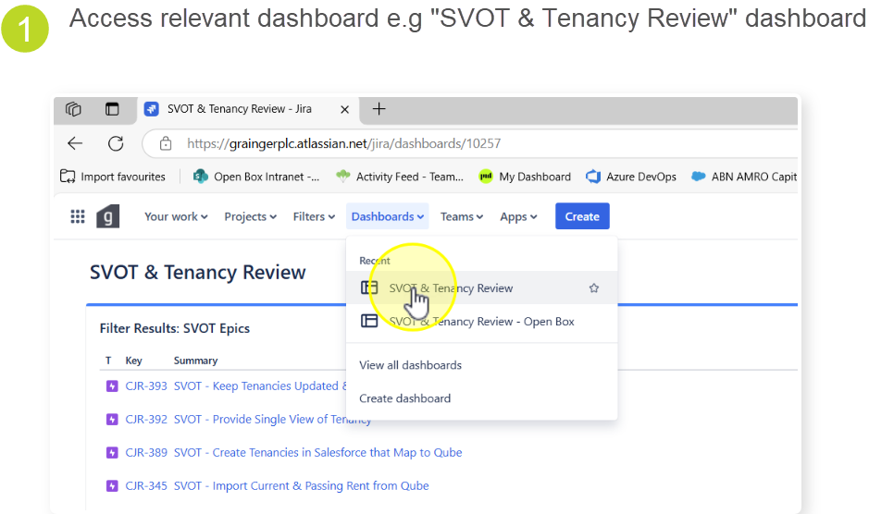
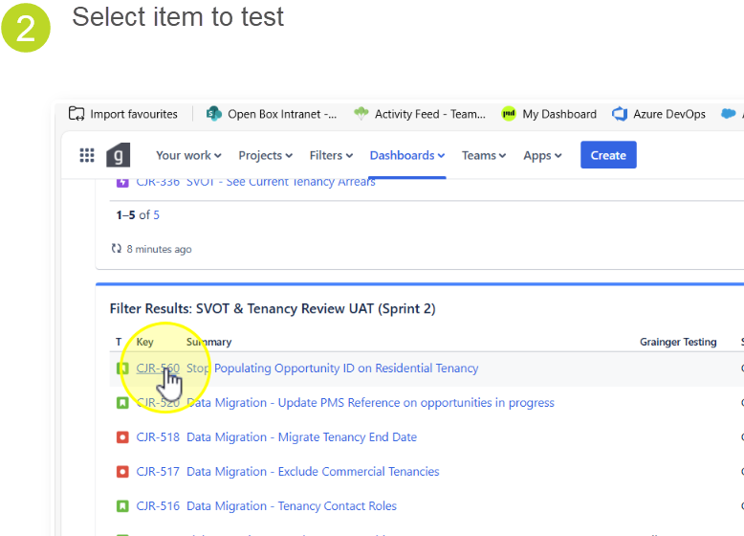
Accessing UAT Work Items

Slide 5
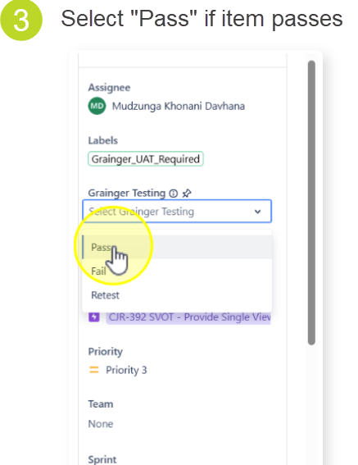
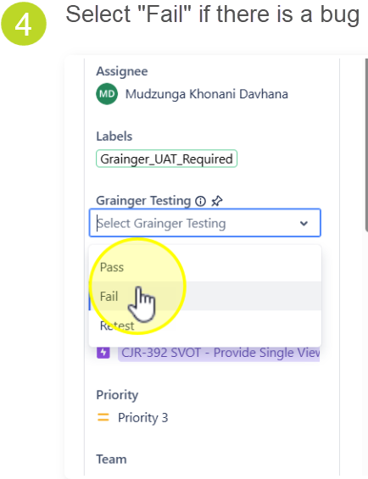

Slide 6
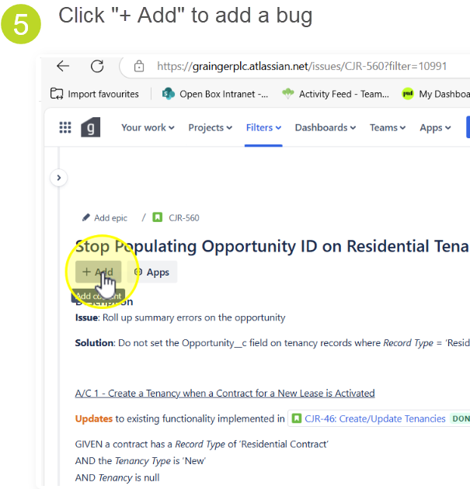
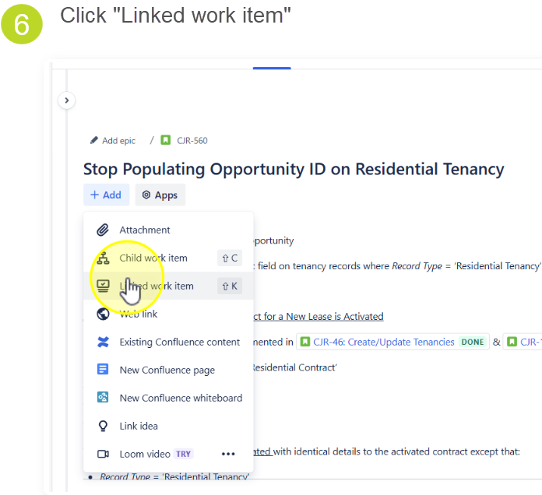
Logging a Bug

Slide 7
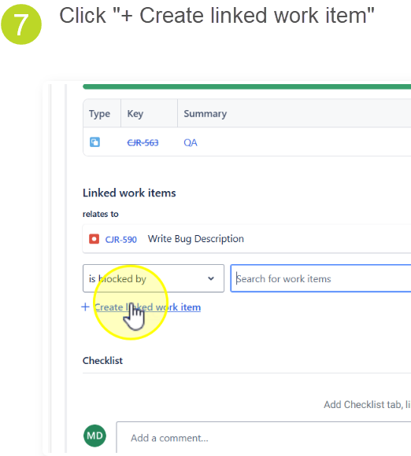
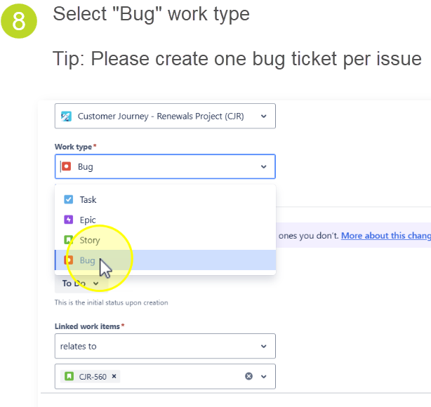

Slide 8
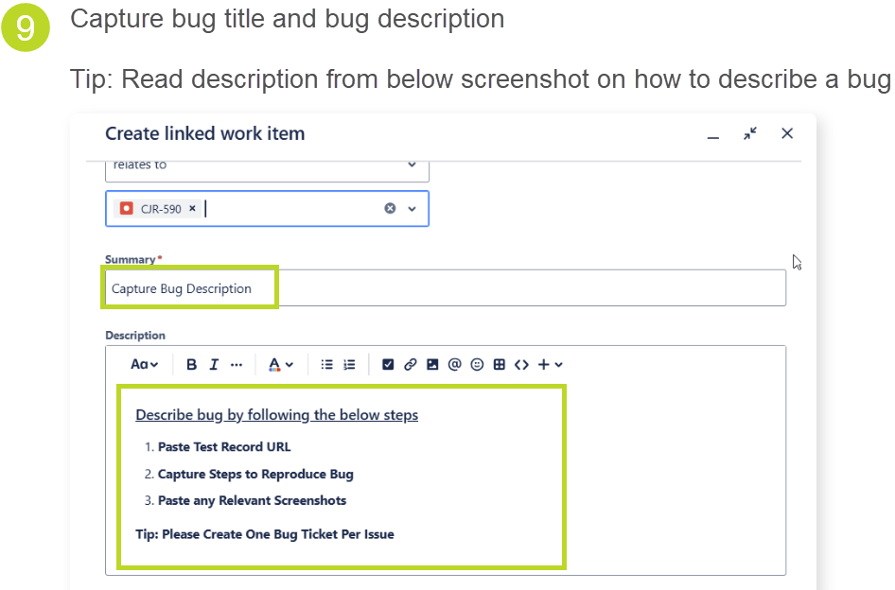
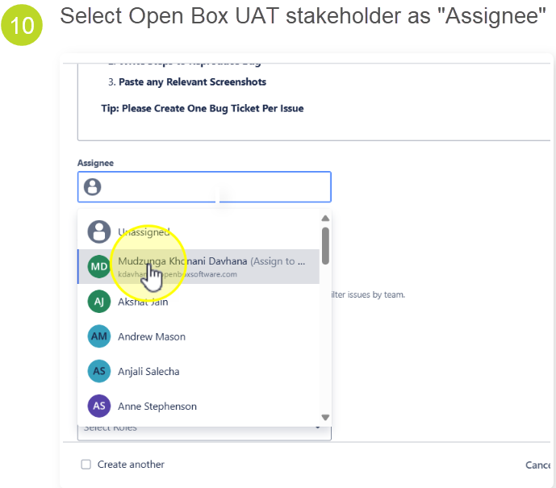

Slide 9
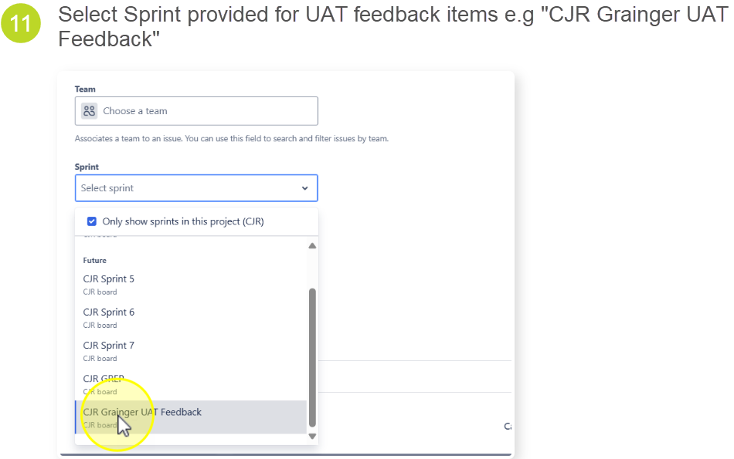
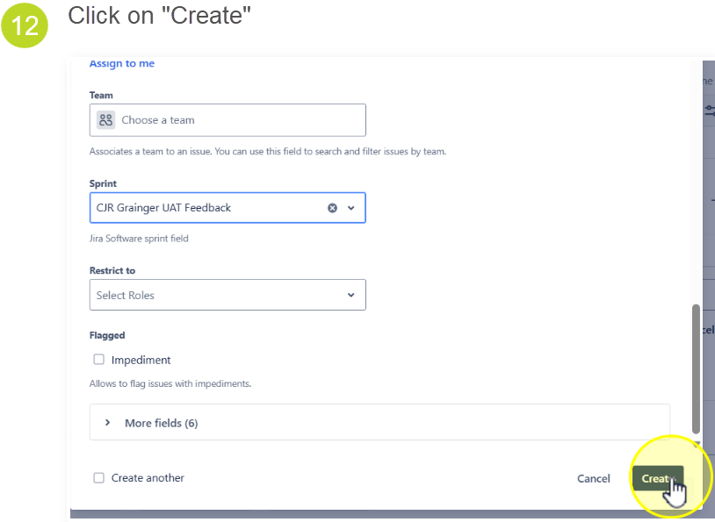

Slide 10
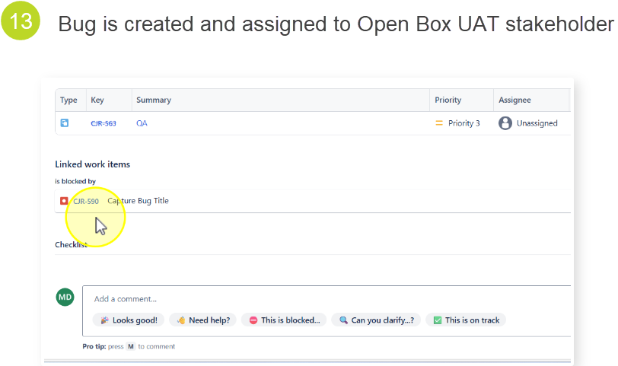
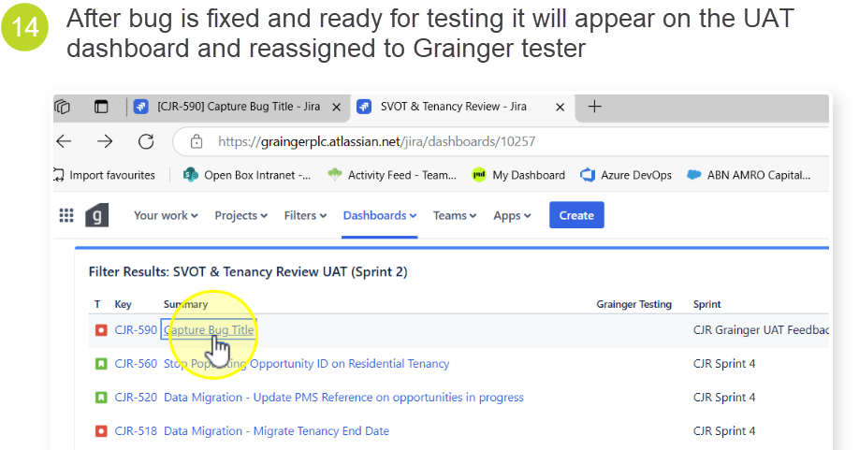

Slide 11
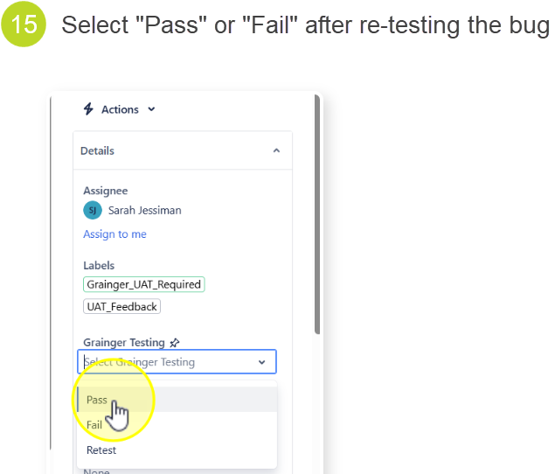
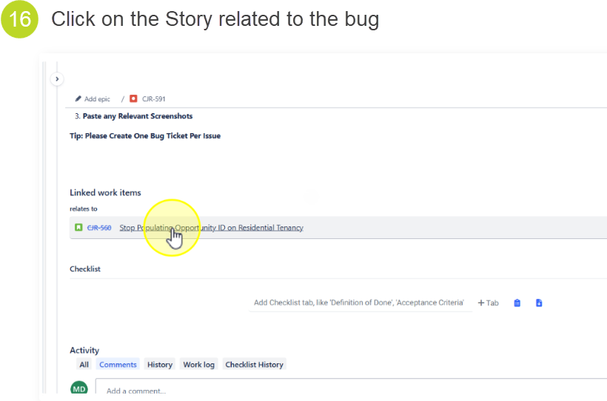

Slide 12
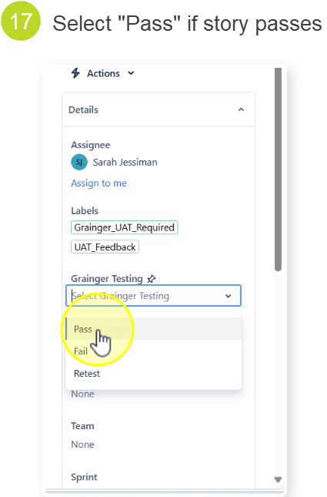

Slide 13
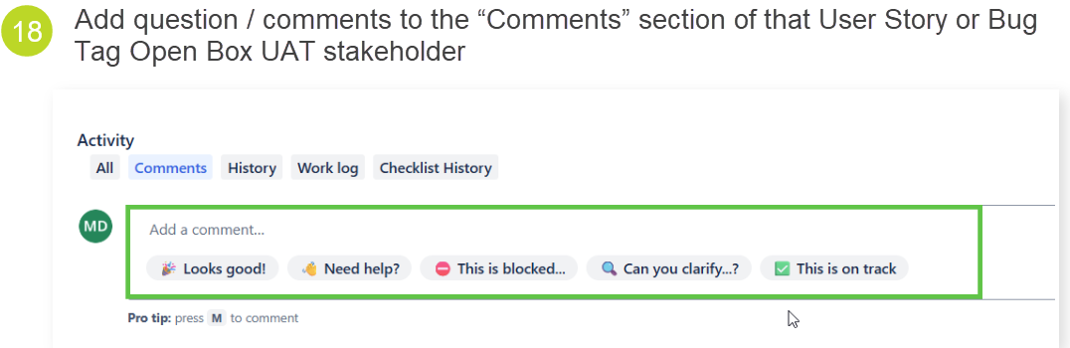
Raising Comments / Questions

Slide 14
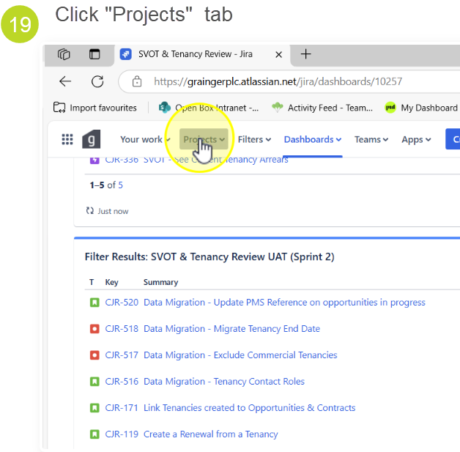
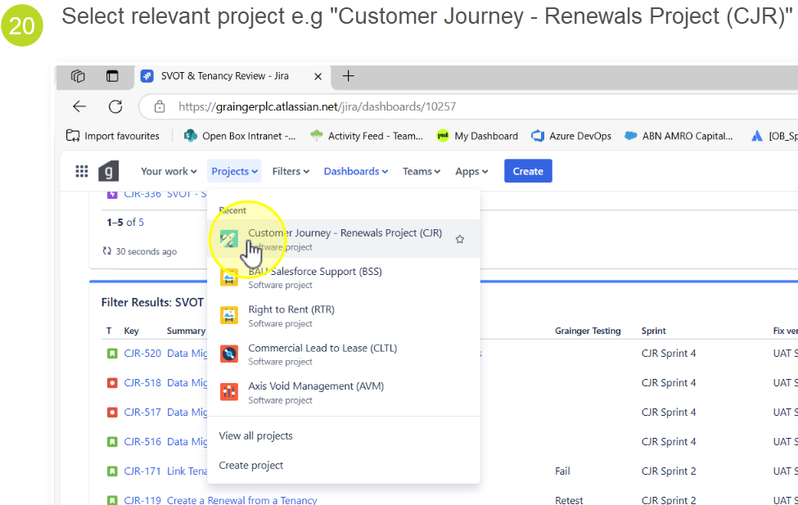
Logging a User Story

Slide 15
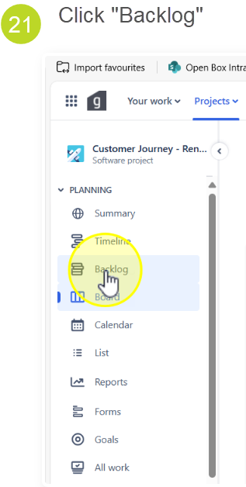
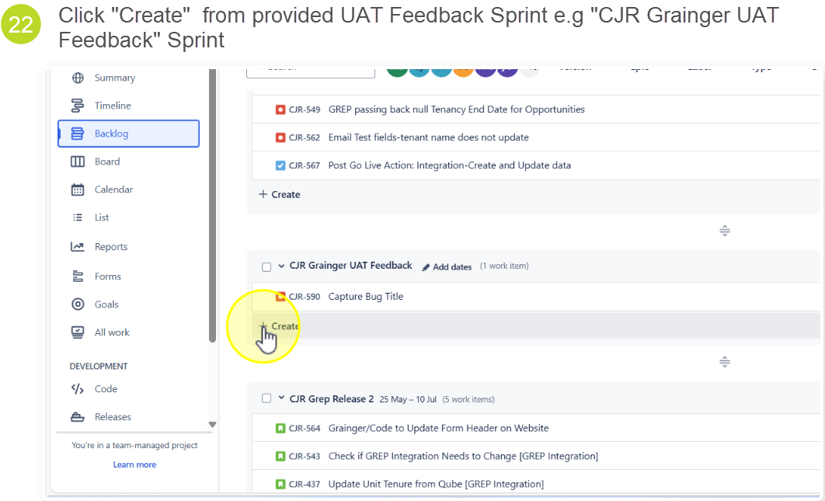

Slide 16
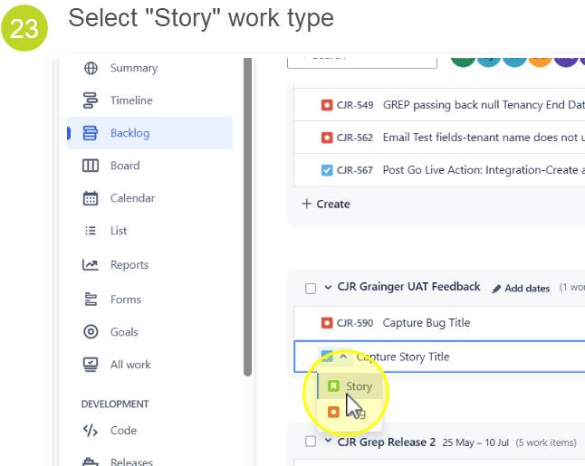
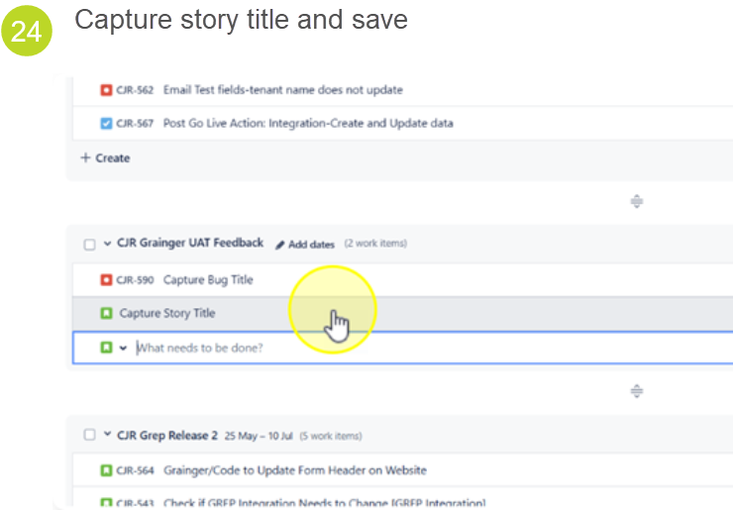

Slide 17
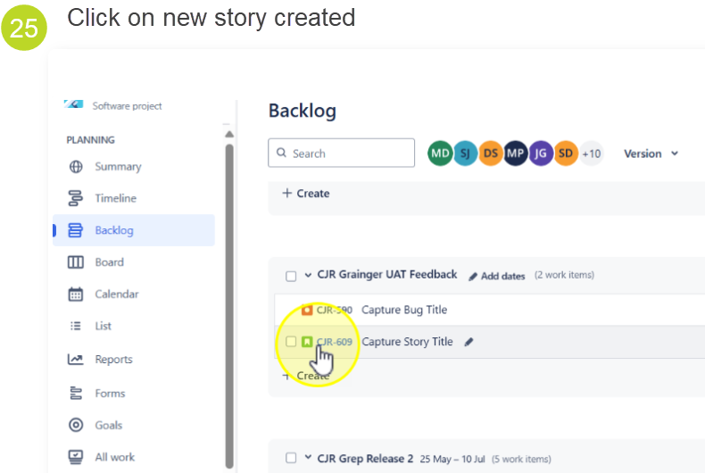
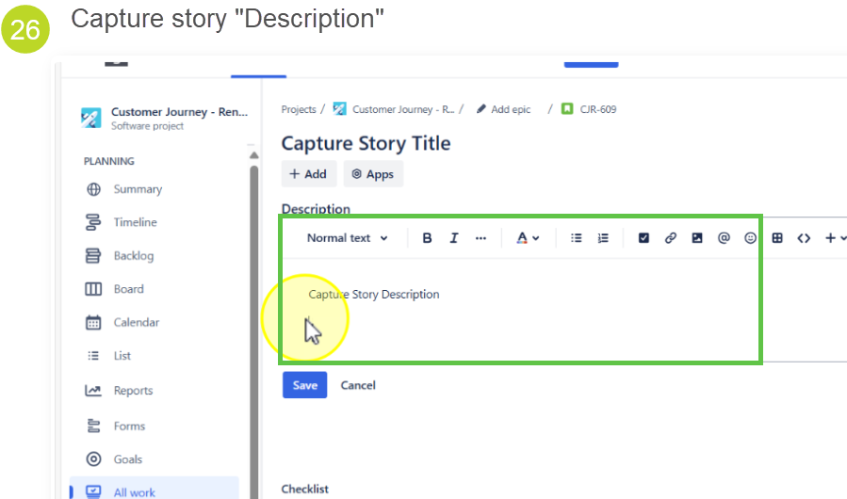

Slide 18
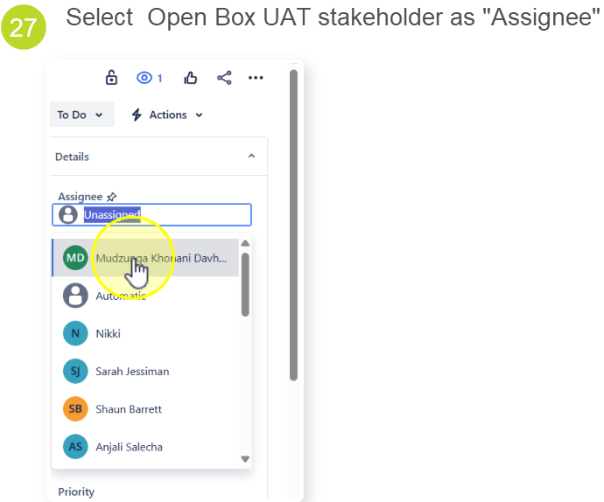

Slide 19

Thank You

